Slide 1
GitHub Pages Tutorial

Slide 2
Today’s Lecture
Create a github account
Create a new repository
Set up page and go live
GitHub Pages is a static site hosting service that takes HTML, CSS, and JavaScript files straight from a repository on GitHub, optionally runs the files through a build process, and publishes a website.
Uses: By hosting your Pages in the repository, you are making it open source. It is a great way to showcase your skills, provides examples to others and generally be an awesome developer.

Slide 3
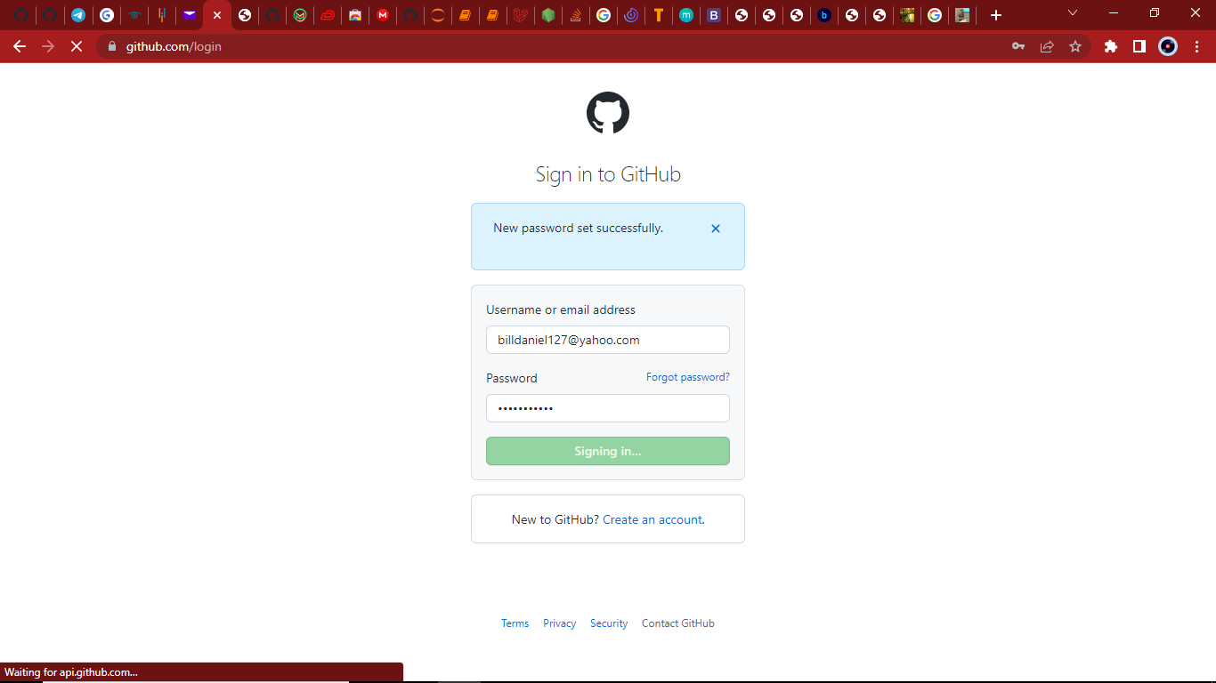
Create a Github Account
As a new user to github, you have to create an account by signing up using you name and email and follow up some authentication puzzle to create the account

Slide 4
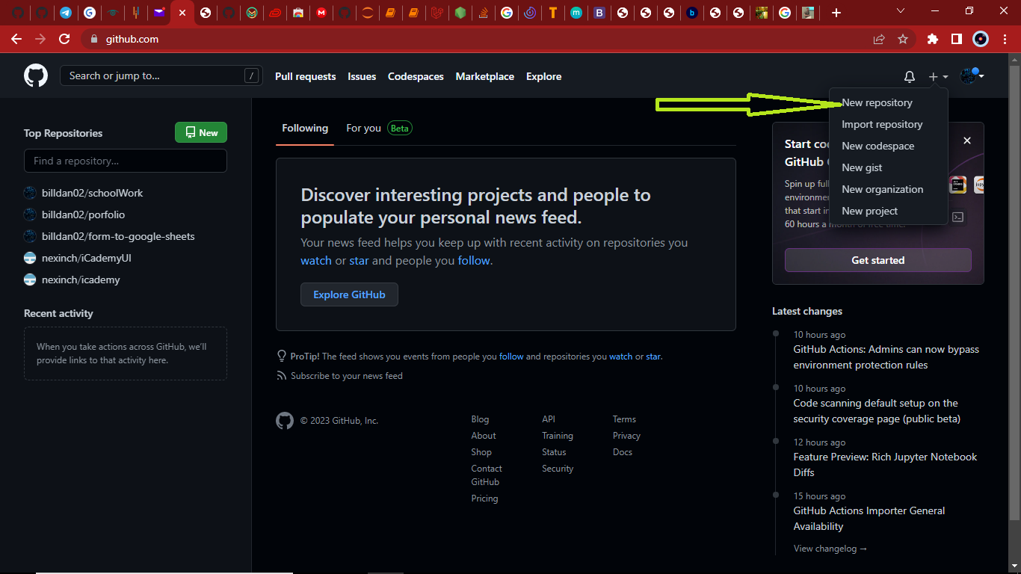
Create repository
To create a github page, first create a new repository

Slide 5
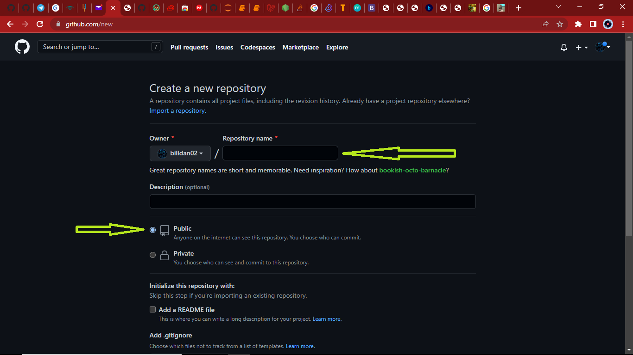
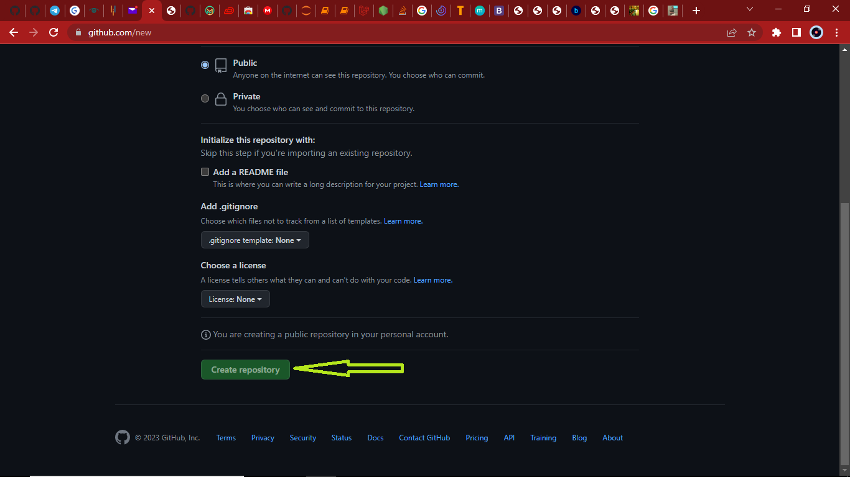
Create repository
Inside this image, give a name to your repository and ensure that it is public, to make it visible to everyone to wants to see your work.

Slide 6
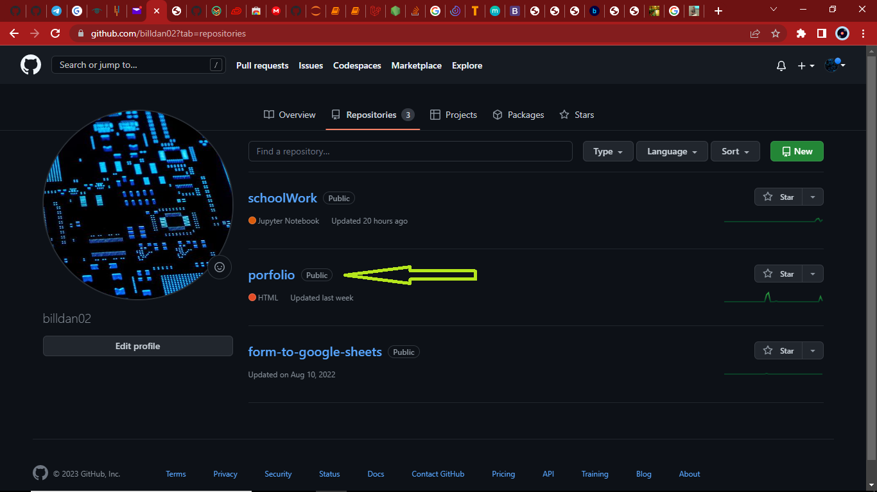
The repository is then created as shown below. The public at the side indicates that it can be seen by every who has a github account but no user can edit your work.

Slide 7
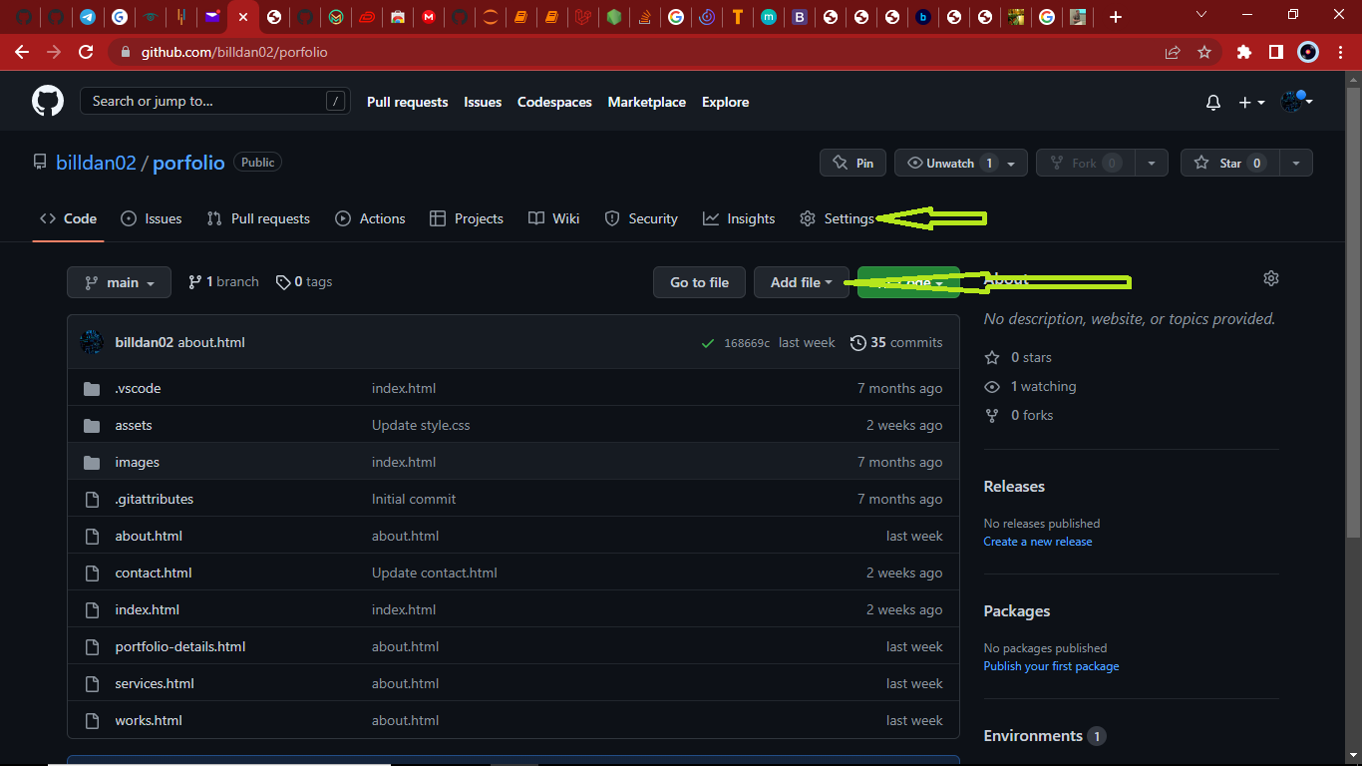
Inside your repo, there is an option to add new files, which is where you upload your html work. Next thing is to head on to the settings of your repo as shown below

Slide 8
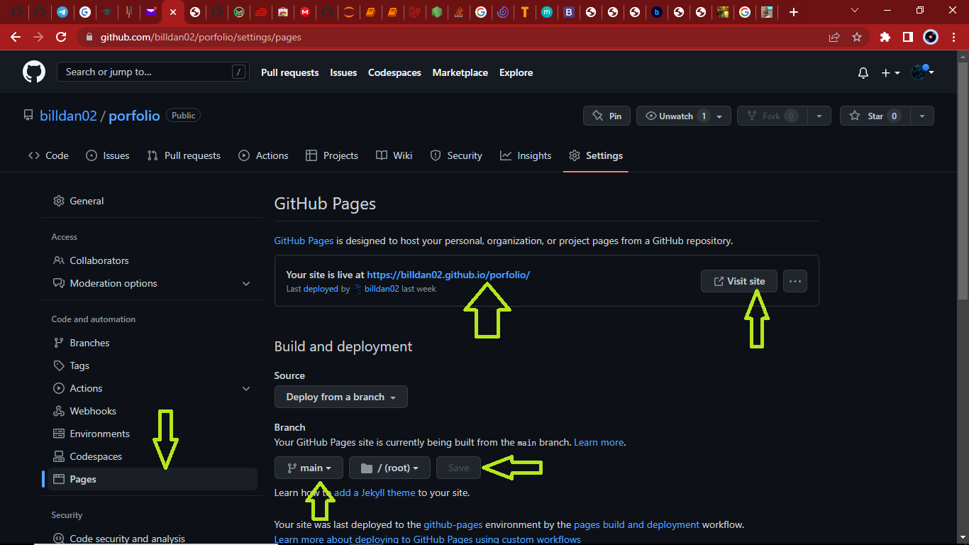
Generate repo site link
In the setting, head on to pages on the left hand side menu where it will display as such in the image. Ensure that at the branch is built on main because it is where all changes eventually get merged back into.
Then to click on save and the site will be generated. And you can be able to view your work

Slide 9
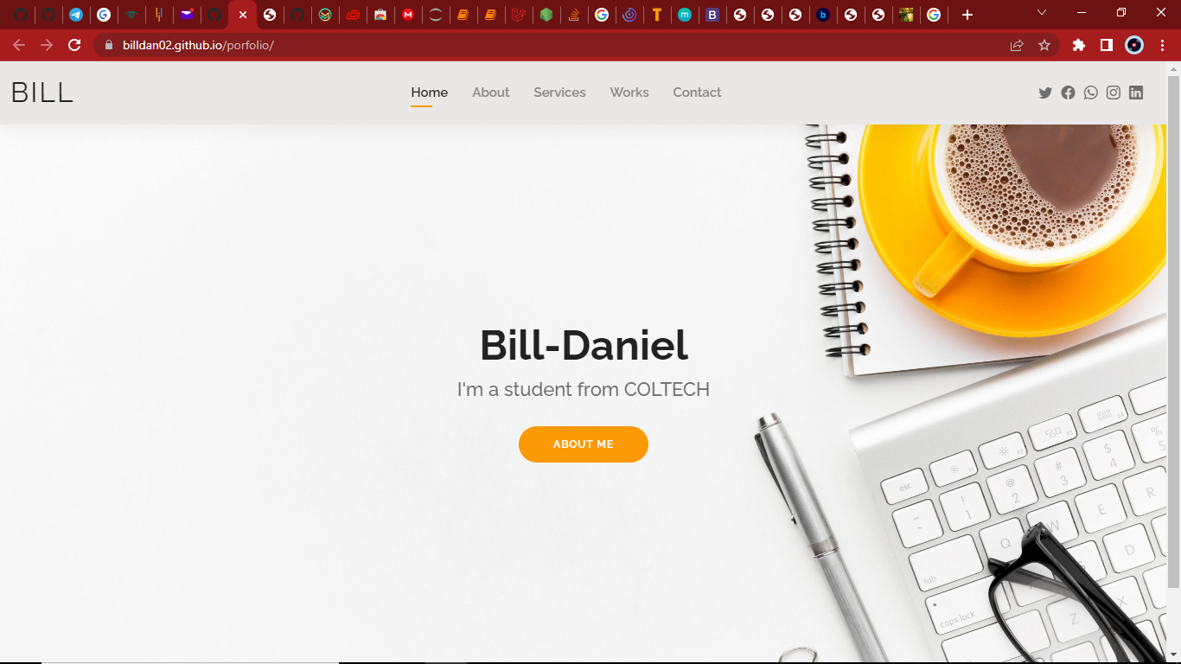

Slide 10
THANK YOU.
FOR YOUR ATTENTION

